Slide 1

INFORMATION TITLE
PROJECT PPT
TITLE:-REAL TIME IOT-BASED WATER QUALITY MONITORING SYSTEM
Subtitle:- Ensuring Safe and Clean Water

Slide 2
REAL TIME IOT- BASED WATER QUALITY MONITORING SYSTEM
Presented by:-
1. G. P. Gangadhar Rao (2249A04E7)
4. V. Ajaya Reddy (22491A04C6)
2. SK. Yedulla Hussen (23495A0425)
5. M. Pujitha (22491A0438)
3. K. Navya Bhargavi (22491A0491)
6. M. Venkata Ajay kumar (22491A04G8)
UNDER THE GUIDENCES OF:- A. Subbarao sir
DEPARTMENT OF:-ELECTRONICS AND COMMUNICATION ENGINEERING

Slide 3
OUTLINE
Abstract
Introduction
Literature review
Motivation
Objective
Existing Method
Proposed Method
Hardware & Software involved
Advantages & Applications
System Architecture /proposed Work Block Diagram
Implementation
Testing/Simulation
Results & Discussions
Conclusions & Fucture Scope
References

Slide 4
ABSTRACT
The main objective of this real time IOT based water quality monitoring system using internet of things is to find the quality of the water i.e. how the pH content varies and sending message to the corresponding authorities
These project Real Time IoT-based water quality monitoring system is used to designed. To continuously assess the safety and purity of water in real-time. The system uses sensors to measure critical parameters like pH, temperature, and total dissolved solids. These sensors are connected to an IoT platform, which collects and transmits the data to a cloud server for analysis. Alerts are generated if any parameter exceeds safe levels, ensuring timely intervention to prevent health hazards.
The system is cost-effective, scalable, and can be deployed in various settings, such as drinking water supplies, rivers, or industrial waste management, making it an essential tool for maintaining water quality and public health.

Slide 5
INTRODUCTION
An IoT-based water quality monitoring system is a smart technology designed to keep the health and safety of water in various environments. Water is vital for life, and ensuring its quality is crucial for human health, agriculture, and industry. Traditionally, water quality testing has been done manually, which can be time-consuming and may not provide real-time information. This is where IoT (Internet of Things) comes in, offering a more efficient and reliable solution.
In an IoT-based system, a network of sensors is placed in water sources like rivers, lakes . These sensors continuously measure important water quality parameters such as pH, temperature, turbidity (how clear the water is), and levels of dissolved oxygen or harmful chemicals. The data collected by the sensors is sent in real-time to a central server through the internet. The collected data can be analyzed instantly, and if any parameter goes beyond safe limits, the system can send alerts to authorities or maintenance teams, enabling quick action to address potential issues.
This technology is not only cost-effective and easy to deploy but also scalable, meaning it can be used for small-scale applications like household water tanks . Ultimately, an IoT-based water quality monitoring system ensures that clean and safe water is available, protecting both the environment and public health.

Slide 6
LITERATURE SURVEY
Ref. No | Title & Author | Technique Used | Pros | Cons
1 | IOT Based Water Quality Monitoring System & Sooryansh Singh, Avinash Kumar | IOT, Zigbee, Cloud Computing, Python | Low cost , prevent Diseases , easily installed | Security Risks , limted Coverage
2 | Real Time IOT based Water Quality Management System & Mohammad Salah Uddin Chowdary, Tallha Bin Emran | Big Data Analytics , IOT | Construction Cost is Low , Improving Water Quality | limited battery life , harsh environmental condition
3 | IOT Based Smart Water Quality Monitoring System & Varsha LakshmiKatha, Aruna Patted | IOT , Cloud Computing | Low Power Consumption , Highly Efficiency | Data overload , sensor maintenance
4 | IOT Based Water Quality Monitoring System And Evalution & Shabinar Abdul Hamid, Samihah Abdullah | Wireless sensor Network , IOT | Public Health Consumption , Research & Development | High Initial Investment , Data Quality Issues
5 | Devlopment Of Real-Time IOT Based Water Quality Monitoring System & Huzein Fahmi bin Hawari, Sohail Sarang | Microcontrollers , IOT gateway | reduced water waste , improved compliance | Data privacy concerns , public acceptance

Slide 7
LITERATURE SURVEY
Ref. No | Title & Author | Technique Used | Pros | Cons
6 | Water Quality Monitoring System Using IOT & Nageswara Rao Moparthi, Ch.Mukesh | IOT , Cloud Computing, Temperature sensors | Early warning systems, Real-time monitoring | Limited Coverage, Security Risk
7 | Development Of IOT For Automated Water Quality Monitoring System & Riziq Putri Nourma Budiarti, Anang Tjahjono | Microcontrollers, Cloud Computing, IOT | Automated alerts , cost effective | complexity , sensor maintenance
8 | IOT and WSN Based Water Quality Monitoring System & Simitha K.M, Subodh Raj M.s | Big Data Analytics , IOT, Python | Easy development , Low power consumption | Single purpose , network congestion
9 | Towards an IOT – based water monitoring system with brokerless pub/sub architecture & Alif Akbar Pranata , Dong Seong Kim | Wireless sensor networks, Temperature sensors | Real-time data processing, Low latency | Device discovery, Limited quality of service
10 | Towards an IoT-based water quality monitoring system with brokerless pub/sub architecture & R . Dhanalakshmi , Jone Anandh | Cloud Coumputing, Fog Coumputing, IOT | Cost-effective, Improved security | Debugging difficulties, Sensor calibration challenges

Slide 8
MOTIVATION
1.Access to clean and safe water is essential for human health, environmental sustainability, and economic growth. With increasing pollution from industrial activities, agricultural runoff, Traditional water quality monitoring methods, such as manual sampling and laboratory analysis, are time-consuming, costly, and fail to provide continuous real-time data, which is critical for addressing water quality challenges effectively.
2. This project is motivated by the urgent need for an efficient, scalable, and cost-effective solution to monitor water quality in real-time. Leveraging IoT technology offers the potential to transform water quality management by providing continuous data streams, early detection of contamination, and actionable insights. The system can help identify and mitigate water quality issues proactively, reducing health risks and preserving aquatic ecosystems.
3. Additionally, the integration of IoT with cloud platforms for data storage and analytics ensures accessibility and transparency of water quality data. These systems helpful to environmental protection. By automating monitoring processes, this project also reduces reliance on human resources.

Slide 9
OBJECTIVE
The objective of an IoT-based water quality monitoring system is to provide continuous, real-time monitoring of water quality to ensure it meets safety and health standards . It Aims To
Ensure Water Safety: Detect and alert on any contamination or unsafe levels of water quality parameters like pH, turbidity, and chemical pollutants.
Enable Timely Intervention: Provide instant alerts for quick corrective action to prevent health risks or environmental damage.
Automate Monitoring: Reduce the need for manual sampling and testing by automating the data collection process.
Enhance Decision-Making: Provide data-driven insights for better management of water resources and pollution control.
Support Scalability: Adapt to different environments, from small-scale systems like household tanks to large-scale water networks

Slide 10
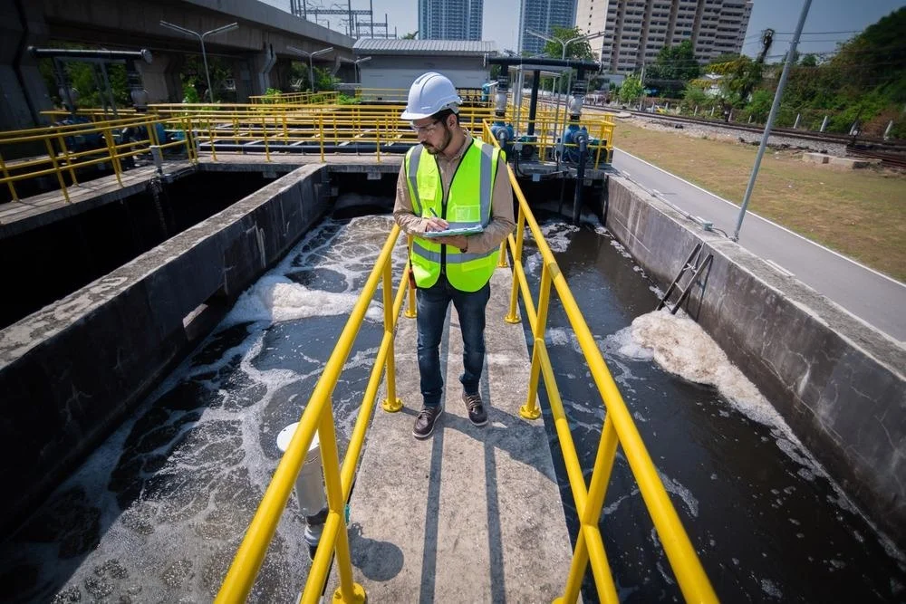
EXISTING METHOD
The term "existing method" refers to the current or commonly used techniques, processes, or approaches that are already in place for achieving a particular goal. Existing methods of IoT-based water quality monitoring systems use a combination of sensors, wireless communication, and cloud-based data processing to keep track of water quality in real-time. Here's how they typically work:
Sensors: These systems use a variety of sensors to measure key water quality parameters such as pH, temperature, turbidity (how clear the water is), dissolved oxygen, and the presence of harmful chemicals. These sensors are placed directly in water sources like rivers, lakes, reservoirs, or water treatment facilities.
Data Collection: The sensors continuously collect data and send it to a central processing unit, often a microcontroller or an IoT-enabled device. This device processes the data locally before sending it over the internet to a cloud server for further analysis.

Slide 11
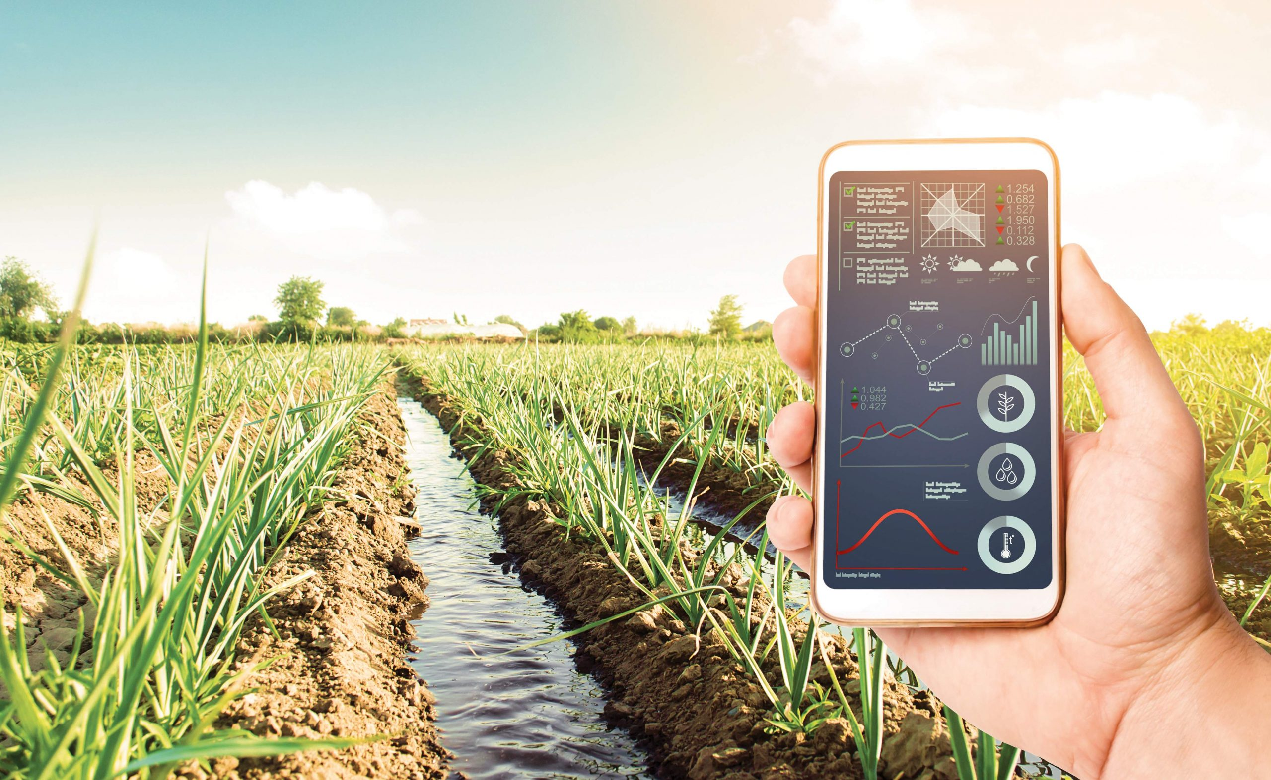
PROPOSED METHOD
System Components:
Sensors: pH, Temperature, and Total Dissolved Solids (TDS) sensors.
Microcontroller: ESP 32
Communication Module: WIFI or Bluetooth
Cloud Platform: IoT platform Blynk server(e.g., ThingSpeak, AWS IoT, or Google Cloud IoT Core) for data storage, analysis, and visualization.
Alert System: SMS or email notification system for alerts and warnings.
Methodology:
Sensor Deployment: Install sensors in the water body or distribution network.
Data Collection: Sensors transmit data to the microcontroller at regular intervals.
Data Processing: Microcontroller processes data, performs calculations (e.g., water quality index), and sends data to the cloud platform.
Data Visualization: Cloud platform displays real-time data, historical trends, and water quality indexes.
Alert Generation: System generates alerts when water quality parameters exceed predefined thresholds.
Notification: Alert system sends notifications to authorities, stakeholders, or the public via SMS or email.
Benefits:
1. Real-time Monitoring: Instantaneous water quality monitoring and alerts.
2. Improved Decision Making: Data-driven decisions for water management and treatment.
3. Public Health Protection: Early warnings for waterborne diseases and contaminants.
4. Optimized Treatment: Real-time data for optimized water treatment processes.
5. Increased Transparency: Public access to water quality information.

Slide 12
BLOCK DIAGRAM:-
ESP32
Cloud platform
Phone
230V
5V ADAPTER
TEMPERCTURE SENSOR
BLYNK SERVER
PH SENSOR
TDS SENSOR

Slide 13
EXPLANATION OF PROPOSED WORK
Sensor Deployment: Water quality sensors are installed in the water body or distribution network to measure parameters like pH, temperature, turbidity, conductivity, dissolved oxygen, and total dissolved solids.
Data Acquisition: Sensors transmit data to a microcontroller or data logger at regular intervals (e.g., every 10-15 minutes).
Data Processing: The microcontroller processes the data, performs calculations (e.g., water quality index), and formats it for transmission.
Data Transmission: The processed data is sent to a cloud platform or server via a communication module (e.g., Wi-Fi, cellular, or LoRaWAN).
Cloud Processing: The cloud platform stores, analyzes, and visualizes the data in real-time, using tools like dashboards, graphs, and maps.

Slide 14
EXPLANATION OF PROPOSED WORK
Alert Generation: The system generates alerts when water quality parameters exceed predefined thresholds or indicate abnormal conditions.
Notification: Alerts are sent to authorities, stakeholders, or the public via SMS, email, or mobile apps.
Data Storage: Historical data is stored in the cloud for future analysis, trend monitoring, and compliance reporting.
Data Visualization: Real-time and historical data is displayed on dashboards, providing insights into water quality trends and patterns.
The IoT water quality monitoring system works on the following principles:- IoT Connectivity: Sensors and devices communicate with each other and the cloud platform.- Real-time Data Processing: Immediate processing and analysis of data for timely alerts and actions.- Cloud Computing: Scalable storage, processing, and analysis of large data sets.- Machine Learning: Algorithms can be applied to predict water quality trends and detect anomalies.

Slide 15
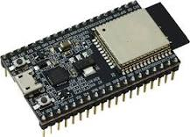
HARD WARE AND SOFTWARE INVOLVED
1.ESP 32
The ESP32 is a series of low-cost, low-power system-on-chip microcontrollers with integrated Wi-Fi and dual-mode Bluetooth capabilities. It was developed by “Espressif” Systems, a “Chinese company” that specializes in the production of microcontrollers and wireless communication modules.
The name "ESP32" refers to the same (fact)that it is the successor to the ESP8266, another popular microcontroller from Espressif. These is “32-bit “architecture of the processor used in the microcontroller The ESP8266 module enables microcontrollers to connect to “2.4 GHz Wi-Fi
The ESP32 is a powerful, versatile microcontroller designed for applications that require wireless connectivity, such as IoT (Internet of Things) devices, smart home products, and other embedded systems.
Specifications:- ROM:128kb, RAM:32kb,Wi-Fi range:100 m, GPIO:23,
logic level:3.3v, Analogue channel:18

Slide 16
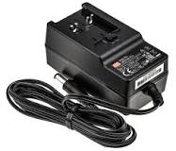
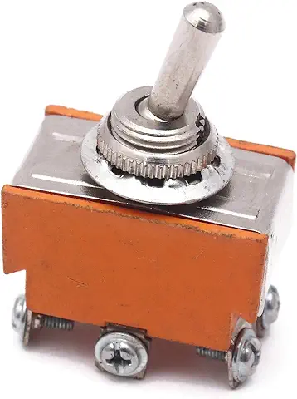
2. INPUT JACK
An input jack is a type of electrical connector used to receive signals or power from an external source. It serves as the entry point for electrical signals, such as audio, video, or data, into a device.
Specifications:-dc adapter,current:1 Amax, voltage;5v, Type:dc, technology:smps
3. MAIN SWITCH
An input switch refers to a device or control mechanism that allows the user to select between different input sources or activate a specific input on a device. The term can apply to various contexts, such as electronics, audio/video equipment, or computing.
Specifications:Type:DpDt push pull, Current:1Amax, Voltage:5volt

Slide 17
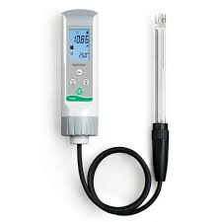

4.PH SENSOR
A pH sensor is a device used to measure the pH level of a solution, indicating how acidic or alkaline the solution is. The pH scale ranges from 0 to 14, where 7 is neutral, values below 7 indicate acidity, and values above 7 indicate alkalinity.
Specifications:- Input Voltage:3.5v, Range:7.5-1, inbuilt opamp:IM741, Type:Digital
5.BLYNK SERVER
The Blynk Server is a central component in the Blynk IoT ecosystem, designed to manage data exchanges between IoT devices (like microcontrollers), the Blynk mobile app, and other external services. It serves as the backbone that facilitates the interaction of these devices, enabling them to communicate, store data, and manage IoT applications.
Specifications :- Device Connectivity & Communication , Data Handling and Storage, Security,User Management

Slide 18
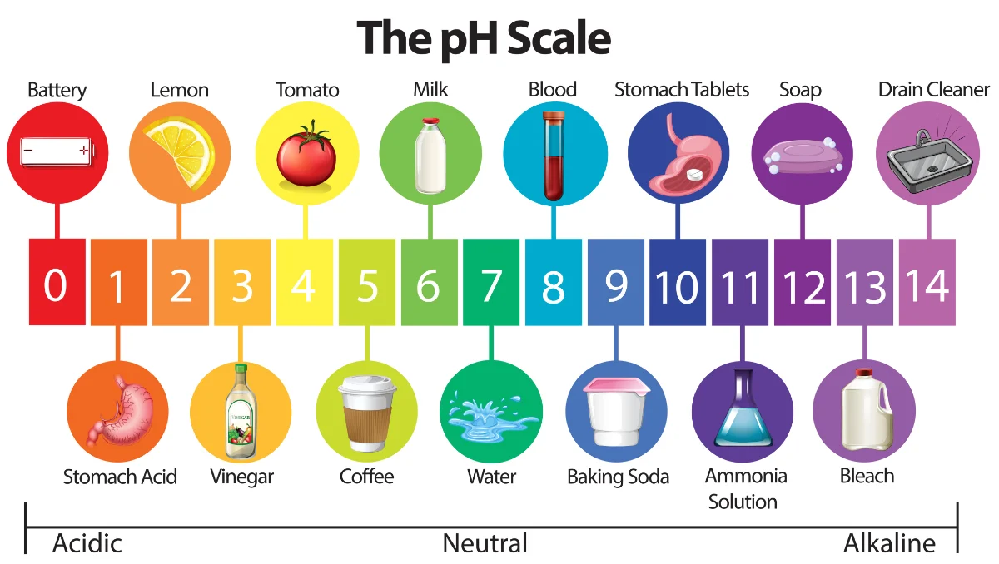
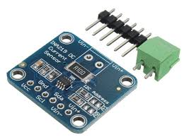
6.PH CONVERTER
A pH converter Typically refers to an “electronic device or module “that takes the output from a pH sensor or electrode, which measures the “acidity or alkalinity of a solution”, and converts it into a more usable form. “This output is usually an electrical signal that can be read by other devices”, such as controllers, display units, data loggers, or computer systems
Specifications:-model:INA219,voltage:34Dc,current:3AMAx,Type:Ac/Dc, Protocal:i2c

Slide 19
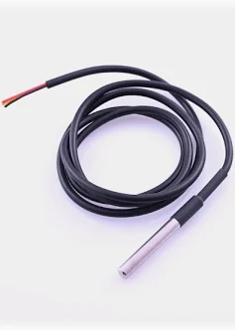
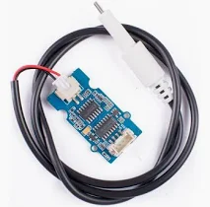
7.TEMPERCTURE SENSOR
A temperature sensor is a device used to measure temperature, meaning it detects the amount of heat or cold in an environment or a specific object. Temperature sensors work by converting temperature measurements into data that can be read by a system or a user.
specifications:- model:Ds18b20,operating voltage:3.5v,Range;-30to +130, type:digital
8.TDS SENSOR
A TDS sensor is a device used to measure the Total Dissolved Solids (TDS) in a liquid, usually water. TDS refers to the concentration of dissolved substances such as salts, minerals, and organic matter in the water. These solids are typically in ionic form, and their concentration is an important indicator of water quality.
TDS sensors usually work by measuring the electrical conductivity of the water. Dissolved solids in water increase its conductivity. The sensor detects this conductivity and converts it into a TDS value. typically expressed in parts per million (ppm). This value indicates the total concentration of dissolved solids in the water.
Specifications:Input voltage:3.3v/5v,Output voltage:-0-2.3v,Working Current:-3-6ma,Tds measurement Range:0-1000ppm

Slide 20
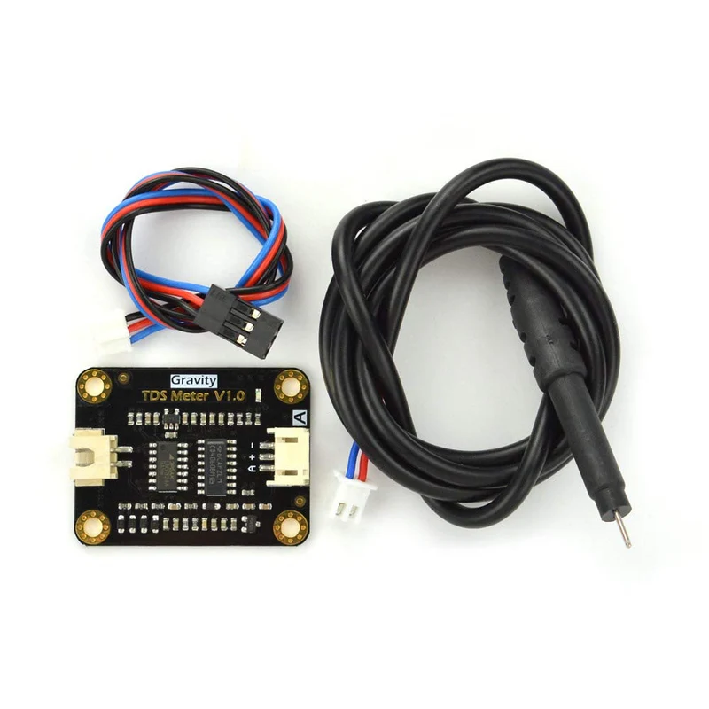
TDS CONVERTER
TDS converter typically refers to a device or tool used to measure and sometimes convert Total Dissolved Solids (TDS) in water. TDS is a measure of the combined content of all inorganic and organic substances contained in a liquid, typically water. These substances are usually in the form of ions, such as salts, minerals, and metals.
Functions of a TDS Converter: Measurement: The primary function of a TDS converter or meter is to measure the TDS level in water. This is usually done by measuring the electrical conductivity of the water, as dissolved solids increase the water's conductivity.
Conversion: The device then converts this conductivity measurement into a TDS value, typically expressed in parts per million (ppm). This value gives an estimate of the total concentration of dissolved substances in the water.
Specifiactions:-a document that provides detailed information about a specific product or technology.

Slide 21
ADVANTAGES
Remote Access
Allows users to monitor water quality from anywhere using a connected device, reducing the need for manual checks.
Automated Alerts
Triggers alerts when water quality parameters fall outside acceptable ranges, helping prevent potential health hazards.
Data Logging and Analysis
Collects and stores data over time, allowing for trend analysis and better understanding of water quality dynamics.
Cost Efficiency
Reduces labor costs associated with manual sampling and testing, and minimizes the risk of costly water contamination incidents.
Customization
Systems can be tailored to monitor specific parameters such as pH, turbidity, temperature, or dissolved oxygen levels.
Continuous Monitoring
Provides real-time data on water quality, enabling timely detection of any changes or contaminants.

Slide 22
APPLICATIONS
Drinking Water Supply
Ensures the safety and quality of public and private drinking water sources.
Aquaculture
Monitors water conditions in fish farms to maintain optimal environments for aquatic life.
Industrial Effluent Monitoring
Tracks the quality of wastewater discharge from factories to ensure compliance with environmental regulations.
Environmental Monitoring
Supports the protection of natural water bodies by monitoring pollution levels in rivers, lakes, and oceans.
Agriculture
Helps in managing the quality of irrigation water, ensuring it is suitable for crops.
Smart Cities
Integrates with other smart city technologies to maintain overall urban water management and sustainability.

Slide 23
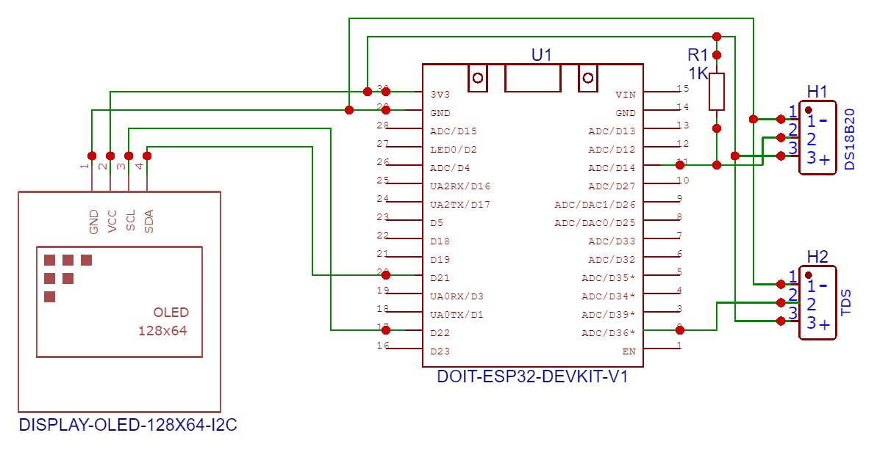
PROPOSED WORK BLOCK DIAGRAM

Slide 24
RESULTS
The system has achieved the following Real-time monitoring Continuous monitoring of water quality parameters, enabling prompt detection of any anomalies or contaminants. Improved accuracy Utilization of advanced sensors and IoT technology ensures accurate and reliable water quality data. Remote monitoring Ability to monitor water quality remotely, reducing the need for physical site visits and enabling real-time decision-making. Data analytics: Advanced data analytics capabilities provide valuable insights into water quality trends, enabling predictive maintenance and proactive measures to prevent contamination. Alert and notification system Automated alert and notification system ensures that stakeholders are promptly informed of any water quality issues, enabling swift action to be taken.

Slide 25
DISCUSSION
The IoT-based system provides real-time monitoring and alerts, enabling prompt action to be taken in case of any water quality issues. The system also provides valuable insights into water quality trends, enabling predictive maintenance and proactive measures to prevent contamination. The use of IoT technology in water quality monitoring has several advantages, including Real-time monitoring: Enables prompt detection of water quality issues. Increased accuracy Reduces the risk of human error in water quality monitoring. Improved efficiency Automates water quality monitoring, reducing the need for manual sampling and analysis. Enhanced decision-making Provides valuable insights into water quality trends, enabling informed decision-making.

Slide 26
CONCLUSION
The implementation of a Real-Time IoT-Based Water Quality Monitoring System represents a significant advancement in environmental management and public health. By enabling continuous, automated monitoring of water quality, these systems ensure that water resources remain safe and within regulatory standards. The ability to remotely access data and receive instant alerts allows for quick responses to potential issues, reducing the risk of contamination and environmental damage. Moreover, the integration of data analytics provides valuable insights that can inform long-term water management strategies. As water resources face increasing pressures from pollution and climate change, IoT-based monitoring systems offer a proactive solution to safeguard water quality and protect ecosystems and communities.

Slide 27
FUCTURE SCOPE
Integration with AI and Machine Learning: The future of IoT-based water quality monitoring lies in integrating AI and machine learning algorithms to predict water quality trends and potential contamination events. These technologies can analyze historical data and provide predictive analytics, enabling more proactive water management.
We implement with The ESP32 is a powerful, versatile microcontroller designed for applications that require wireless connectivity, such as IoT (Internet of Things) devices, smart home products, and other embedded systems.

Slide 28
REFERENCES
"Singh, S., & Kumar, A. (2024). Smart Water Quality Monitoring Using IoT and AI. In Proceedings of the 2024 International Conference on Smart Technologies (pp. 115-122).“
"Chowdary, M. S. U., & Emran, T. B. (2024):- IoT-Based Water Quality Monitoring Systems: An Overview. International Journal of Environmental Monitoring, 15(2), 123-135.“
"LakshmiKatha, V., & Patted, A. (2024). Enhancing Water Quality Monitoring with IoT: A Smart Approach. In Proceedings of the 2024 IEEE Global IoT Summit (pp. 45-52).“
"Hamid, S. A., & Abdullah, S. (2024). Performance Evaluation of IoT-Based Water Quality Monitoring Systems. In Proceedings of the 2024 International Conference on Smart Water Networks (pp. 100-107).“
"Hawari, Huzein Fahmi bin, and Sohail Sarang. (2024). Real-Time Solutions for Water Quality Monitoring Using IoT. Springer.“
"Moparthi, N. R., & Mukesh, C. (2024). Water Quality Monitoring System Using IoT: Design and Implementation. Journal of Smart Environmental Monitoring, 10(3), 150-158.“
"Budiarti, R. P. N., & Tjahjono, A. (2024). Development of IoT for Automated Water Quality Monitoring System. Journal of IoT and Smart Environmental Systems, 8(4), 200-210.“
"Simitha, K. M., & Raj, S. M. (2024). IoT and WSN-Based Water Quality Monitoring System: Design and Implementation. Journal of Environmental Monitoring Systems, 15(2), 115-125."

Slide 29


